Slide 1
Computer Architecture
W1D1: An Intro to Computer System
Jian Weng
Computer Science
CEMSE, KAUST

Slide 2
Roadmap
Misc
Self introduction
Course policies
Why do we learn system?
How do we learn system?
Why bits?

Slide 3
Misc
Who am I?
B.Eng. SJTU ACM Honored Class (2013-2017)
Ph.D. UCLA Computer Science (2017-2023)
Assistant Prof at King Abdullah University of Science and Technology (KAUST) (2024-)
Why do I teach this?
To flatten your learning curve of compilers, architecture, and operating systems

Slide 4
Policies
No Electronic Devices
Attendance
Absence will invalidate all your related grades
Ask your roommates to show up
Generative AI
Can you validate its answer somewhere else?
Google it! Use your own understandings!
Try it! Get your hands dirty!
Plagiarism
No unauthorized collaboration
List all the sources and resources you used

Slide 5
Policies (CONT’D)
Grading
30%
Quizzes right after instructions
Homework labs: No worries, very simple and useful
70%
Final project: 5-stage pipelined CPU
Teaching
Feel free to interrupt me when confused
But I will decide what to teach you

Slide 6
Syllabus
An Intro to Computer Systems (W1-W6, Summer)
Flatten your learning curve for compilers and archs
An Intro to Computer Architecture (W1-W10, Fall)
Let’s do this here!
Implementing a simple 5-stage pipeline CPU
In Register-Transfer-Level (RTL) Language

Slide 7

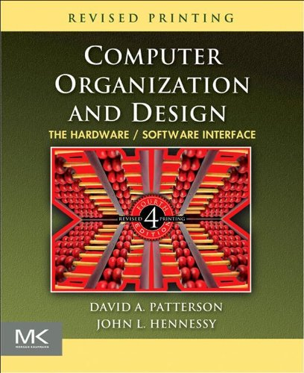
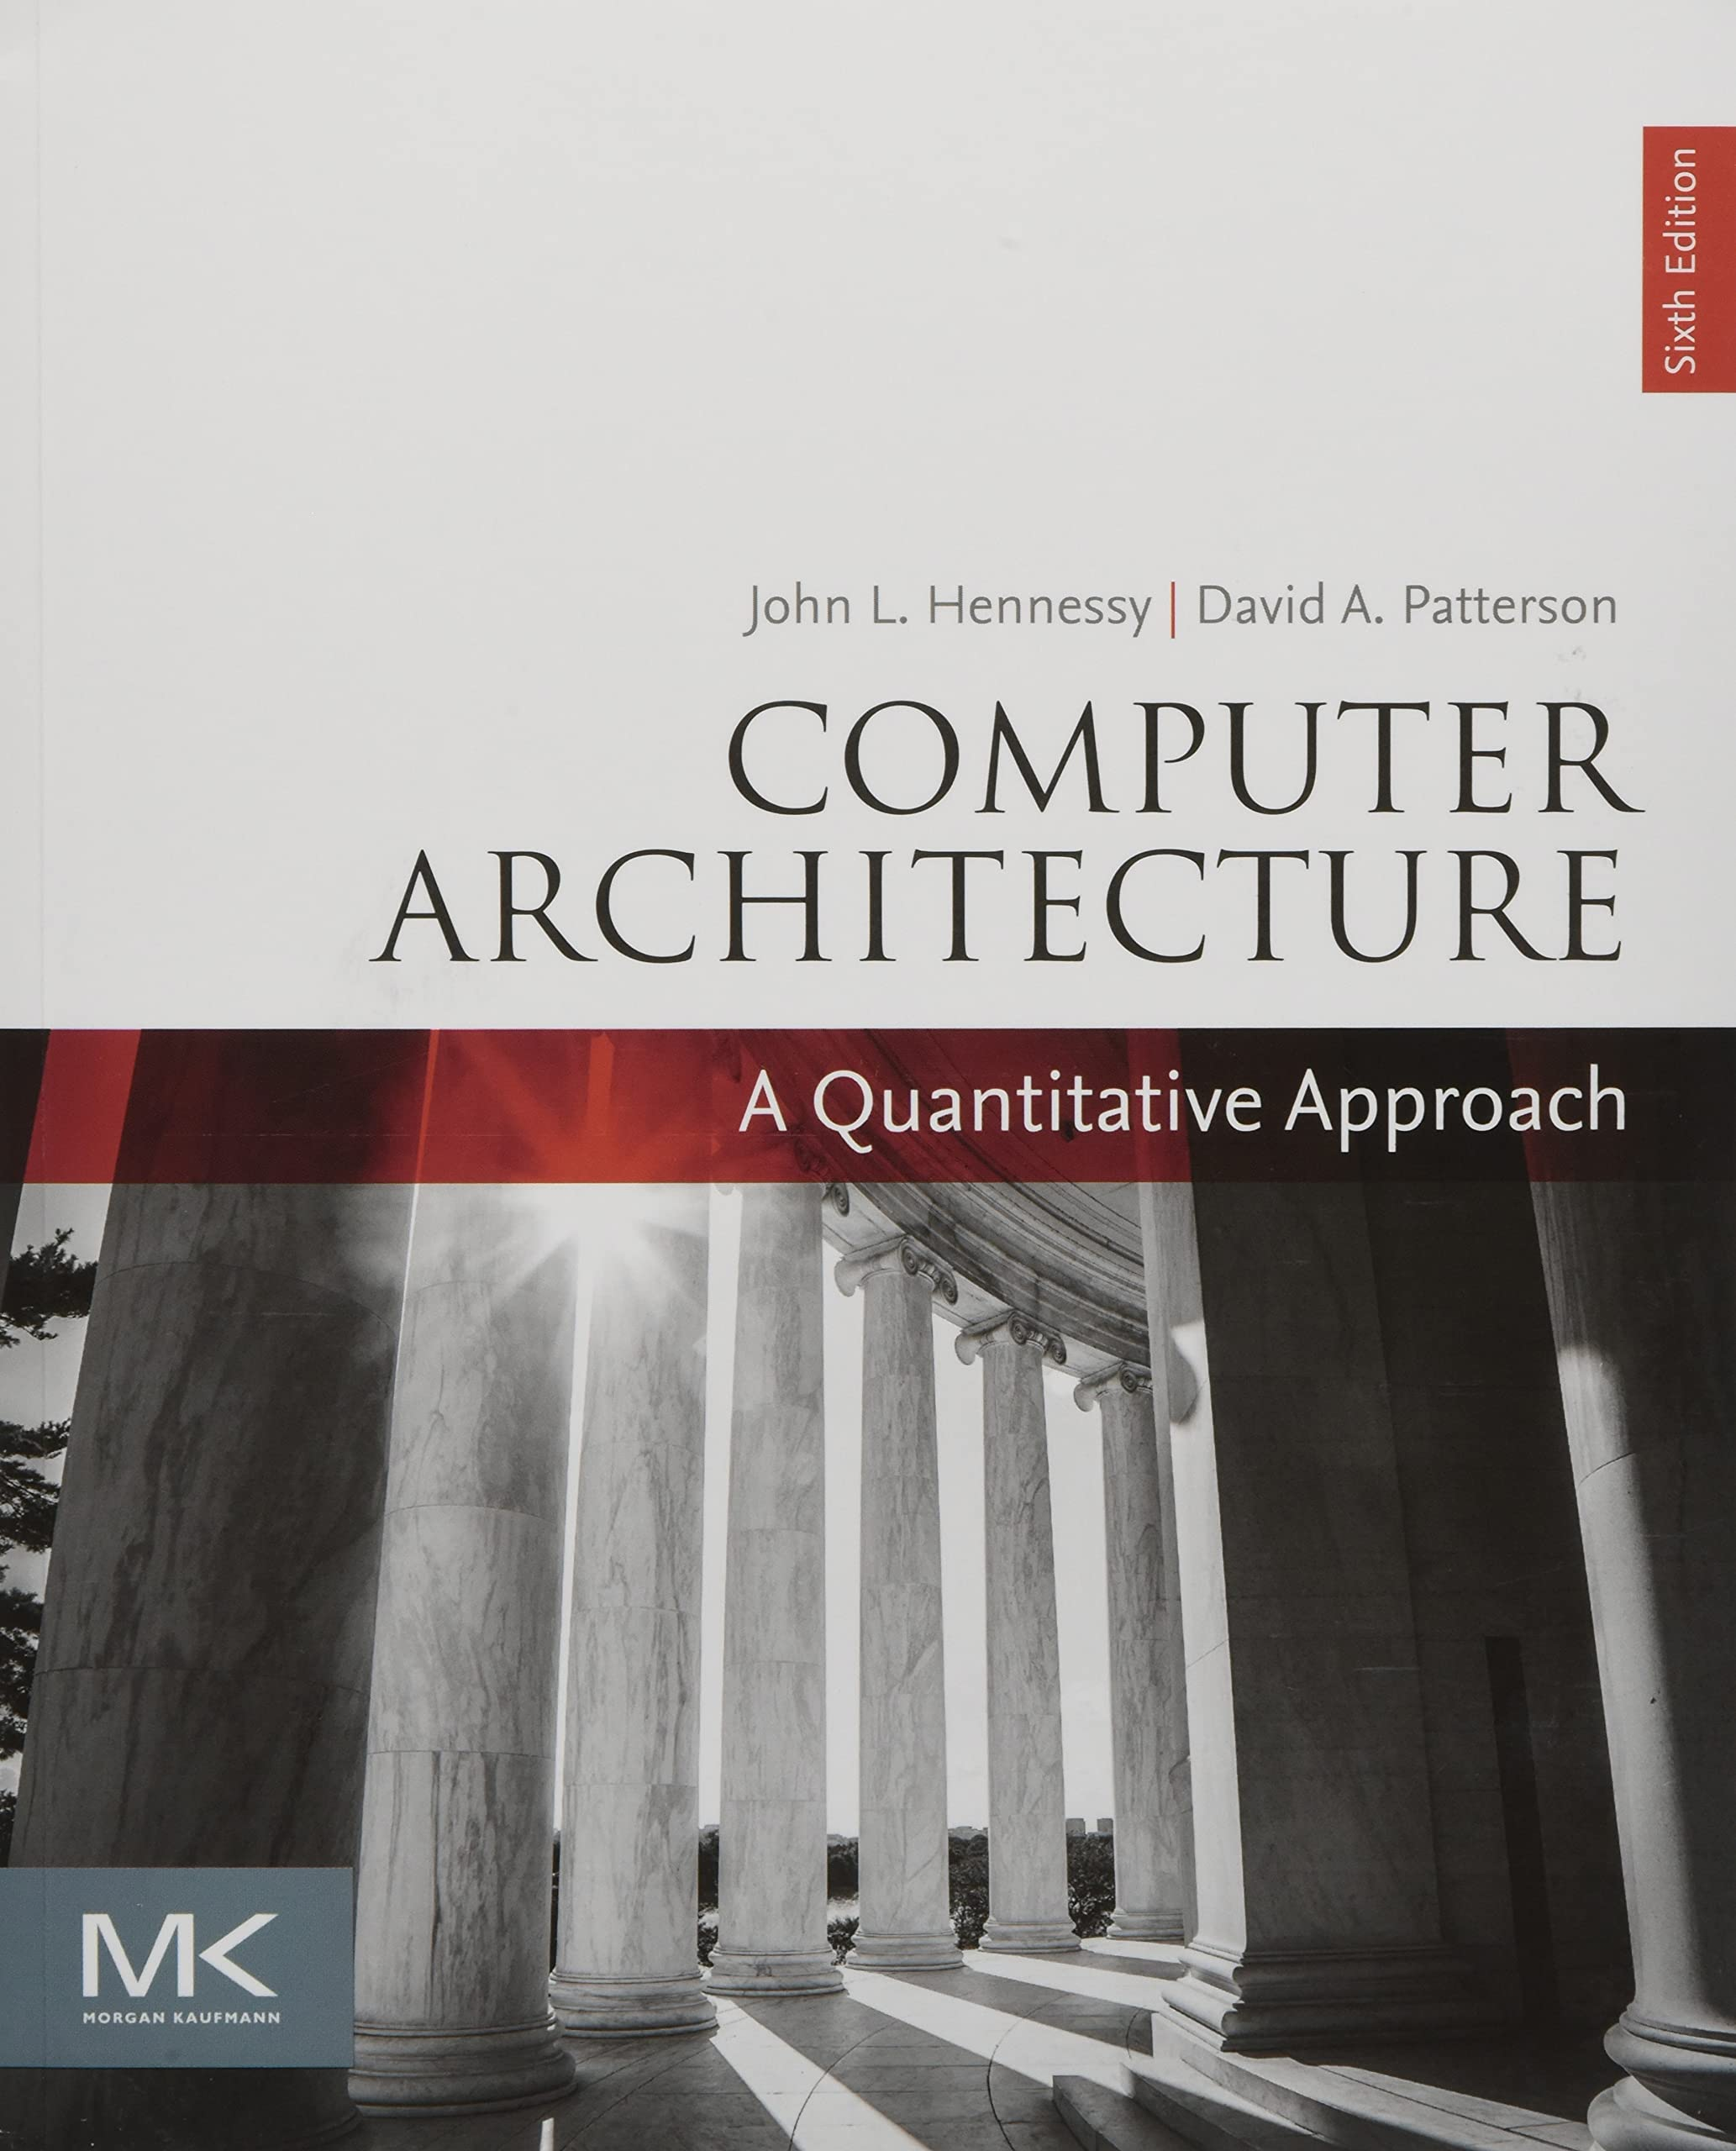
Resources
I learned most of these knowledge from
Computer System: A Programmer’s Perspective
Computer Organization and Design
Computer Architecture: A Quantitative Approach

Slide 8
Roadmap
Misc
Why do we learn system?
System is everywhere
System is beyond system
How do we learn system?
Why bits?

Slide 9
Why do I need to learn systems?
Marxism: Substructure (base) and superstructure
Base determines the superstructure
What does a typical LLM do?
Predict the probability of the next token
What is a basic building block of an LLM?
Transformer
What does a transformer do?
Mix data using matrix multiplications

Slide 10

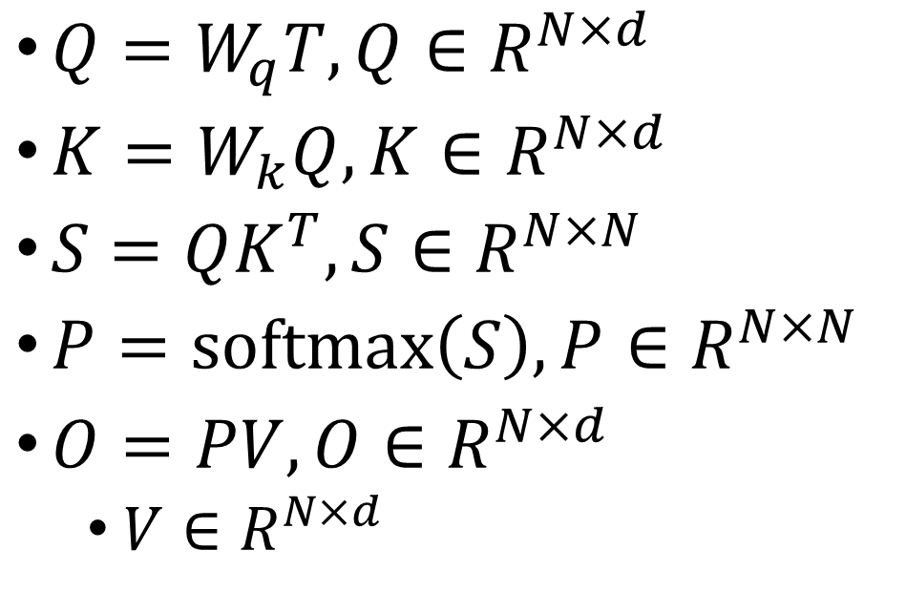

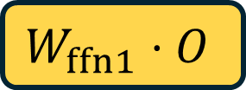

How LLM works: A Typical Transformer Block
Embeddings
$Q=W_{q}T, Q∈R^{N×d}$
$K=W_{k}Q, K∈R^{N×d}$
$S=QK^{T}, S∈R^{N×N}$
$P=softmax\left(S\right), P∈R^{N×N}$
$O=PV, O∈R^{N×d}$
$V∈R^{N×d}$
Dense
Linear
Dense
Linear
Dense
Linear
$$Q⋅K^{T}$$
Softmax
$$P⋅V$$
$$W_{ffn1}⋅O$$
Legend
Projection
Attention
???
$$W_{ffn2}⋅$$
Act.

Slide 11
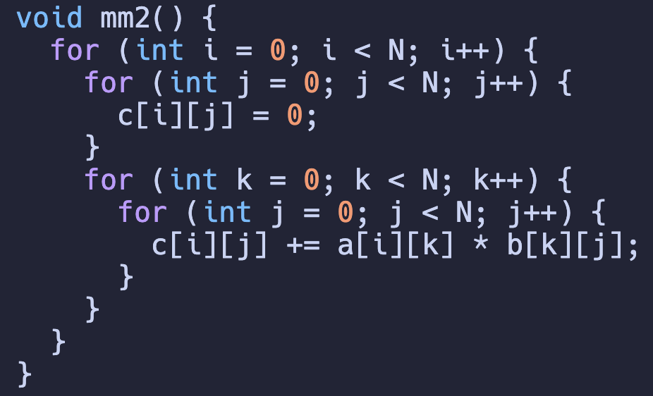
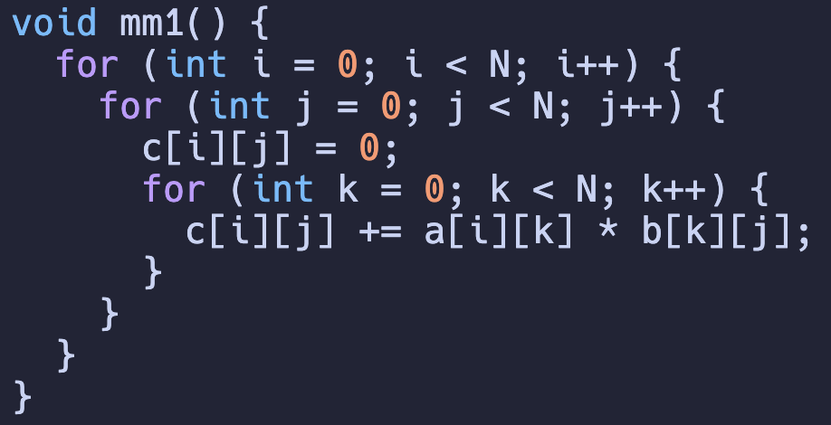
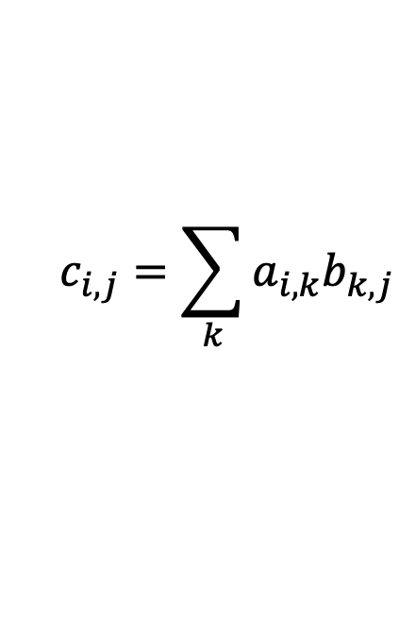
Which program is faster?
$$c_{i,j}=\sum_{k}{a_{i,k}b_{k,j}}$$
Why? This is the effort of compiler and arch together!

Slide 12
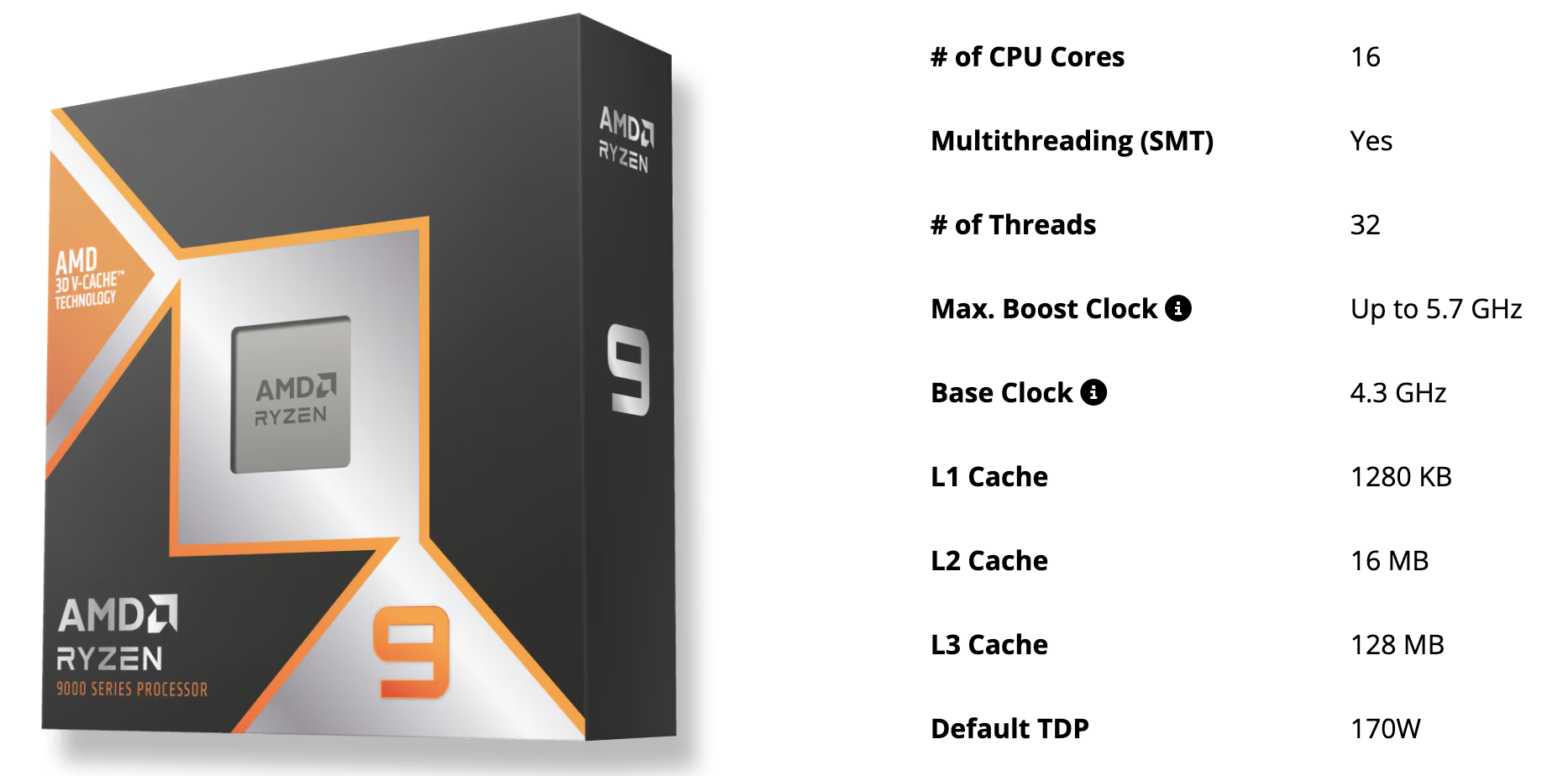
What does all these tech sepc mean?
What is clock freq?
What is cache?
What is core and thread?
Why does TDP matter?
Source: https://www.amd.com/en/products/processors/desktops/ryzen/9000-series/amd-ryzen-9-9950x3d.html

Slide 13
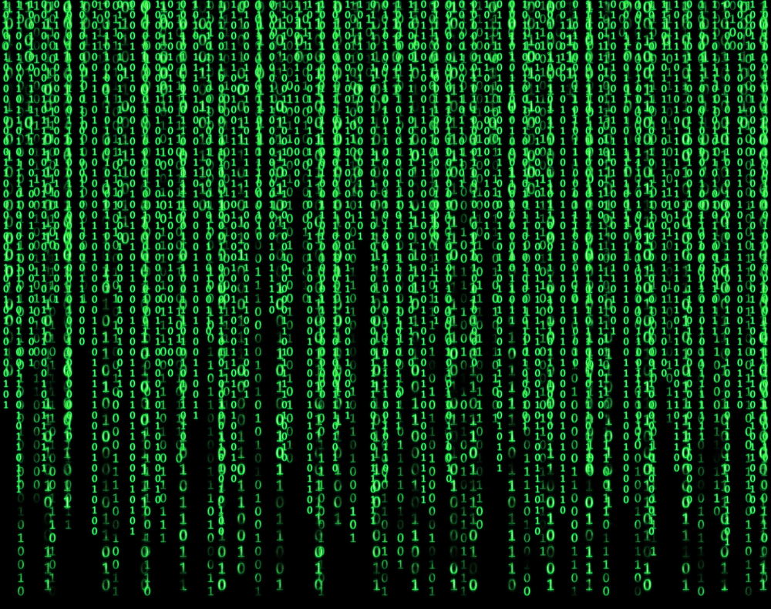
Computers only recognizes binaries (0/1)
What does binaries mean?
Why do we have to stick to binaries?
Source: The Matrix (1999)

Slide 14
What are we goanna learn?
How is a program running on CPU?
Why do we need a compiler?
What does software cracking do?
What does GHz and L1/L2/L3 cache mean when buying a computer?
How can I compile code for/from others to use?
What is the implication of Moore’s Law?
What does a LLM typically do?
Why computer system matters for other areas?

Slide 15
Summary: Did I convince you computer system is both useful and interesting?
What is computer system then?

Slide 16
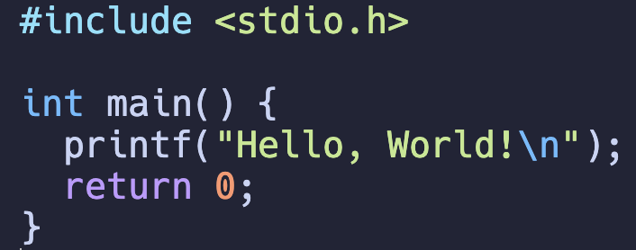
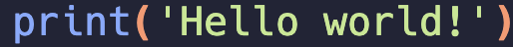
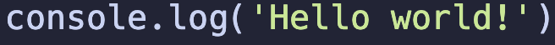
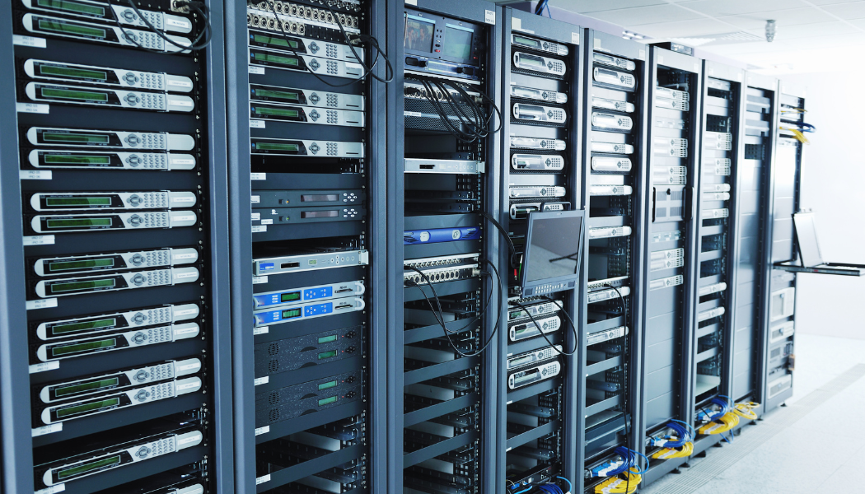
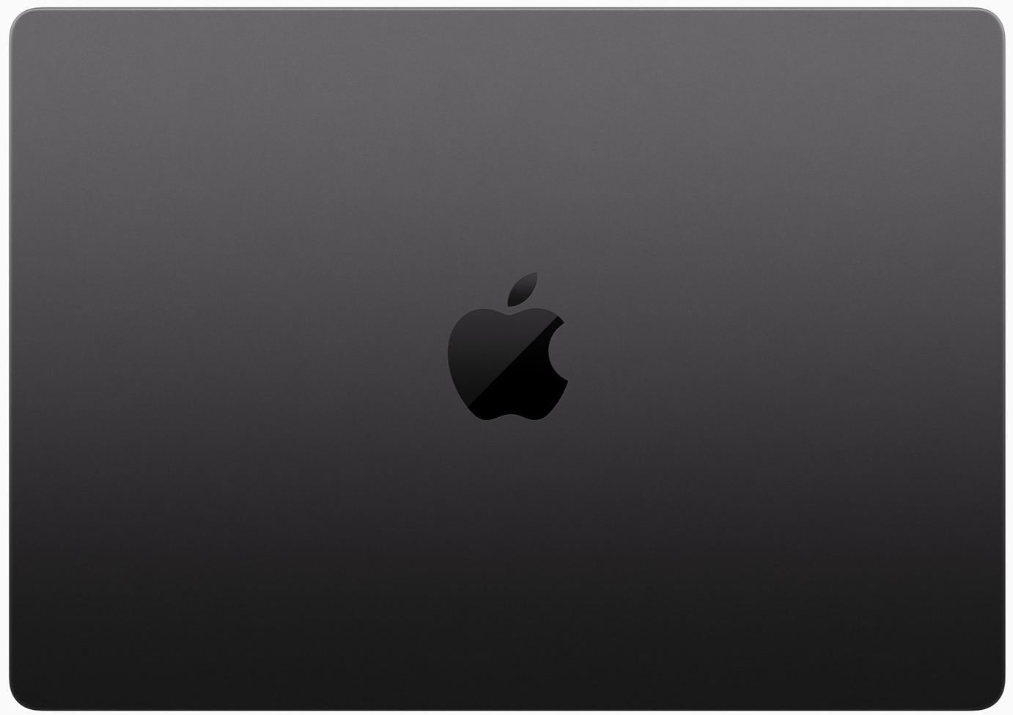

Why can we write once, run everywhere?
Python
JavaScript
C
What is the magic?
Compiler
Interpreter
OS
Some Magic

Slide 17
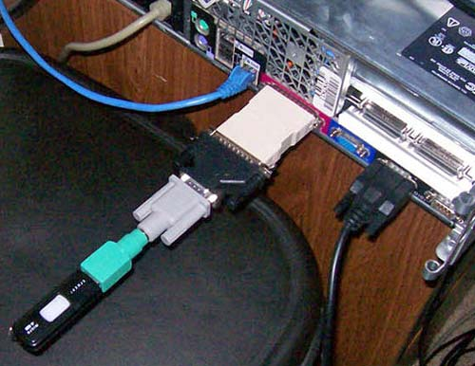
What is a computer system?
Any problem in computer science can be solved by another layer of indirection (abstraction).
——Butler Lampson. Principles for Computer System Design. Turing Award Lecture. February 17, 1993
Define the inputs and outputs
Solve the problem from one end (inputs) to the other end (outputs)
System essentially encapsulates all the low-level details while retaining acceptable performances

Slide 18





Exemplifying Systems
Compiler
Input: High-level Language
Output: Compiled Binaries
System
Translate high-level language
Optimize the performance
Generate the compiled binaries
Operating System
Input: User Interactions
Output: Program Executions
System
Manage the user interactions with devices
Schedule the program executions

Slide 19
What are your inputs to modern computers and outputs to you?
Inputs
Mouse clicks
Keyboard types
Gaming controllers
Cameras
Outputs
Screen
Audio
Application oriented!

Slide 20


Slide 21
System is a system engineering
Application
Today, system stack is a “normal”
Clear boundary b/t sw/hw
Recompile to run
Or even write once run everywhere
But it wasn’t decades ago
Beyond system engineering itself, system is a philosophy.
SDK
Programming Language
Compiler
Software
Executable
Bare Metal
Operating System
Architecture
Driver
Hardware
Devices
EDA
Silicon

Slide 22



System is an engineering philosophy
What is a frontend and backend in website/application design?
FE: User interface, run on users’ devices
BE: Server processing, run on machines in data centers
B/t: POST protocol
Application
SDK
Programming Language
Compiler
Executable
Bare Metal
Operating System
Architecture
Driver
Devices
EDA
Silicon

Slide 23
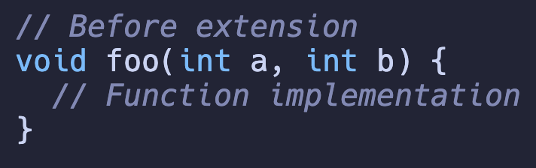
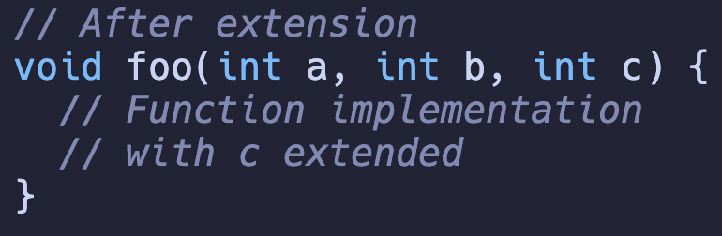
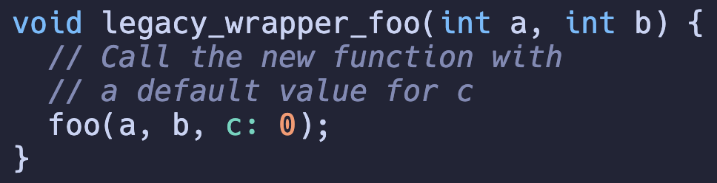
Engineering Philosophy: Manage Legacies
A rule of thumb is to develop it incrementally
Then inevitably you need to manage the legacies
The legacy wrapper creates illusion that old function is
still there

Slide 24
Roadmap
Misc
Why do we learn system?
How do we learn system?
Why bits?
A quick tool to digital signal processing

Slide 25
How do we learn computer systems?
Computer science is NOT unique.
Re-practice the philosophy from existing industry divisions.
Labor division, and modular design
Computer science is unique
You are both a user and a developer
Everything can be tried immediately

Slide 26
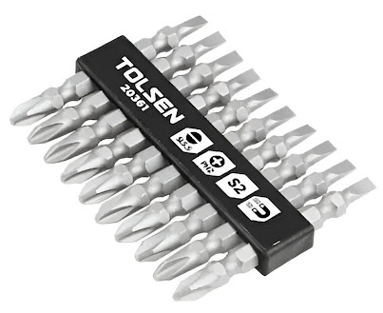
Bit: Basic Information Building Block; But why?
What is bit?
Not this bit
A good enough analogy for non-EE person (just like me)
A valve and fluid model

Slide 27
Valve and Flow – Building block of building block
N-Valve
Low
(Off)
hole
We use some fluid to push the valve
High pressure represents 1
Low pressure represents 0
Valve opens or closes the way for the fluids
There is a small hole on the mover in the middle which allows fluid to flow through
High
(On)
P-Valve
Low
(On)
High
(Off)

Slide 28
Inverter - One of basic building blocks
What does it invert?
High
High
P-Valve
P-Valve
High
(1)
Low
(0)
In
Out
N-Valve
N-Valve
Low
Low

Slide 29
Inverter - One of basic building blocks
What does it invert?
High
High
P-Valve
P-Valve
Low
(0)
High
(1)
In
Out
N-Valve
N-Valve
Low
Low

Slide 30
NAND – Another basic building block
High
High
NAND: NOT (A & B)
NAND itself is Turing Complete
A & B
A | B
A ^ B
out
A
B
Low

Slide 31
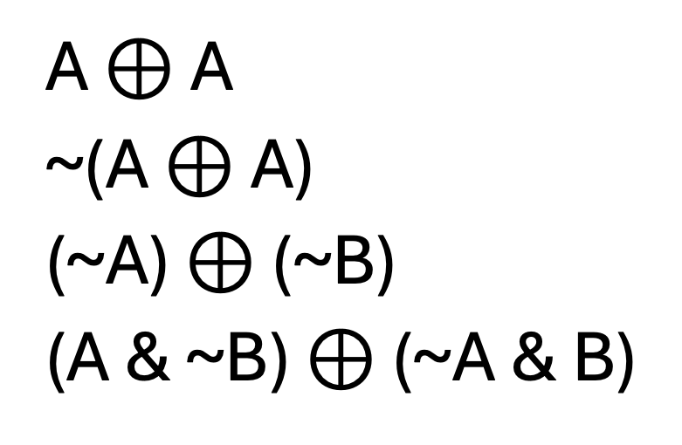
Quiz: Use NAND to write all the remaining operators
Hint: System is all about encapsulation. If you have one operator implemented, just use it for further writeups.
~A =
A & B =
A | B =
A ^ B =
A $⊕$ A
~(A $⊕$ A)
(~A) $⊕$ (~B)
(A & ~B) $⊕$ (~A & B)

Slide 32
Truth table? Look-up table!
A truth table of NAND
What if we regard it as a 4-sized array
[1, 1, 1, 0][idx]
k-bit input we need a (2^k)-sized array
A | B | Result
0 | 0 | 1
0 | 1 | 1
1 | 0 | 1
1 | 1 | 0

Slide 33
What if the table is too big?
Say, we need a 32-bit addition, a + b
Nobody does 2^64 look up table for the results
What do we do?
O₀
O₁
A₀
B₀
A₁
B₁
1 2 8
^
^
+
1 2 8
&
Carry
^
1
2 5 6
&
Carry
|
&
|
&

Slide 34
Why do we need this?
This is the so-called “synthesis”, which converts arithmetics to silicon gates
This is the matter base of binaries
O₀
O₁
A₀
B₀
A₁
B₁
1 2 8
^
^
+
1 2 8
&
Carry
^
1
2 5 6
&
Carry
|
&
|
&

Slide 35
Why do we need this? (CORRECTED)
This is the so-called “synthesis”, which converts arithmetics to silicon gates
If you do a+b in Verilog, the synthesizer will take all the for you
O₀
O₁
A₀
B₀
A₁
B₁
1 2 8
c[i], o[i] =
full_adder(a[i], b[i], c[i-1])
^
^
+
1 2 8
&
Carry
^
1
2 5 6
&
Carry
|
&
|
&

Slide 36
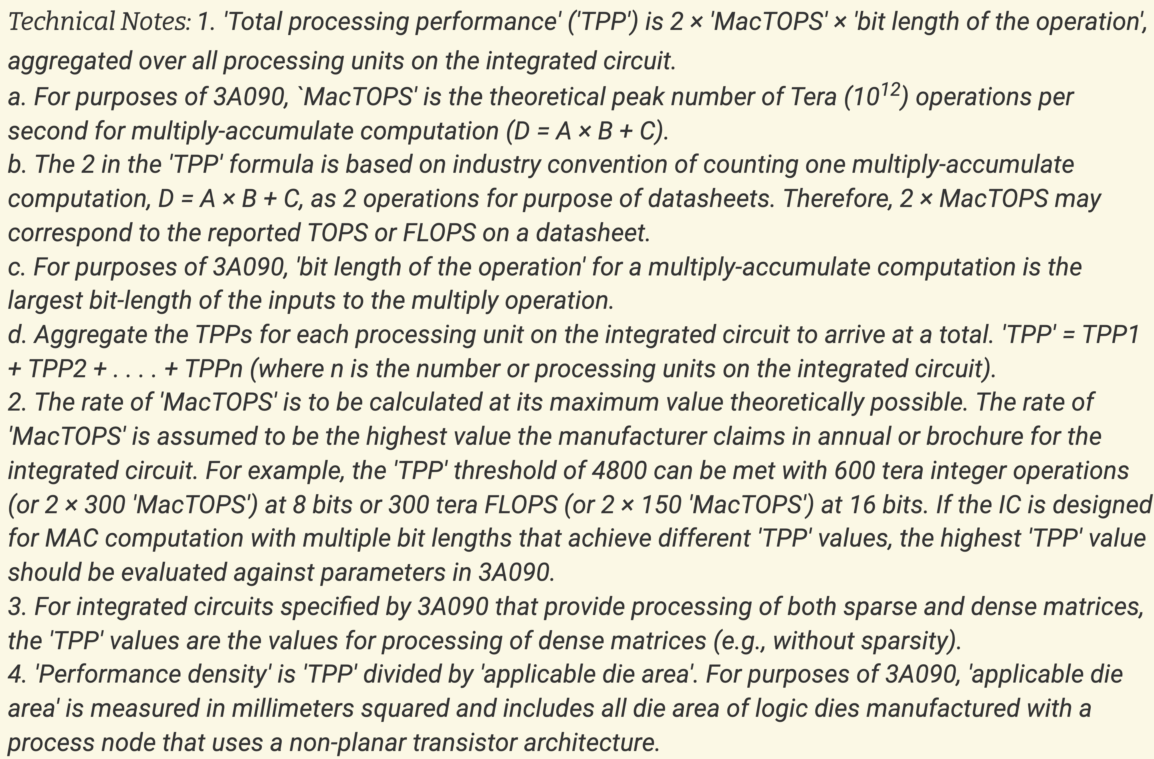
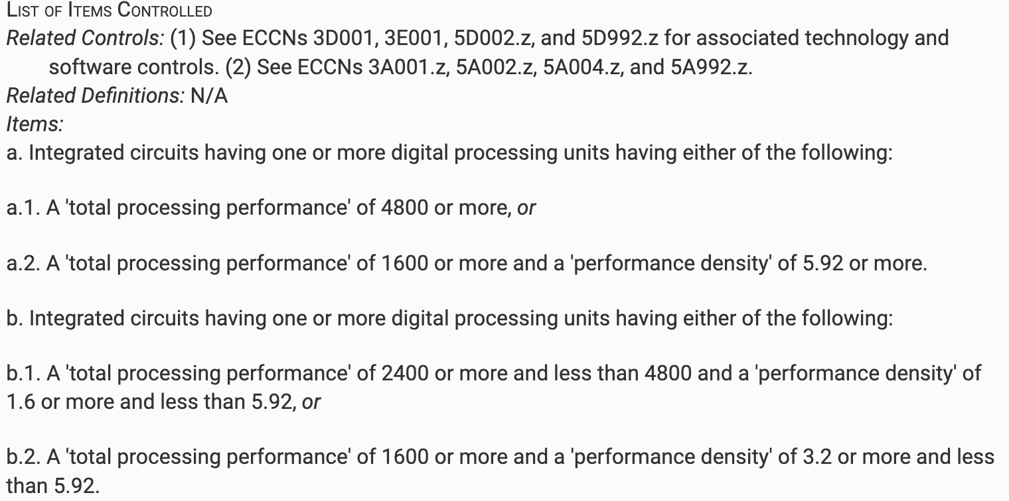
Egg
Bureau of Industry and Security
Code of Federal Regulation Part 774

Slide 37
Summary: Bits are the basic building blocks of information.
Application
SDK
Programming Language
Compiler
Executable
Bare Metal
Operating System
Architecture
Driver
Devices
EDA
Silicon

Slide 38
Summary: Bits are the basic building blocks of information.
Compiler
Executable
Bare Metal
Operating System
Architecture
EDA
This was what we discuss just now
Silicon

Slide 39
Summary: Bits are the basic building blocks of information.
Instruction Set Architecture (ISA)
Instruction Set: A specification to the instructions
Each instruction can be encoded in bits for machine inputs
Program is also data
Each instruction cannot do something too complicated (?)
Compiler
Executable
Bare Metal
Operating System
Architecture

Slide 40
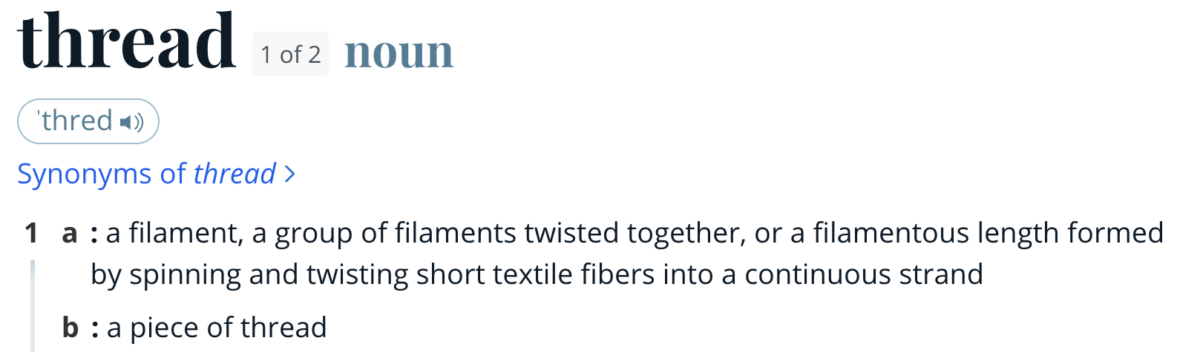

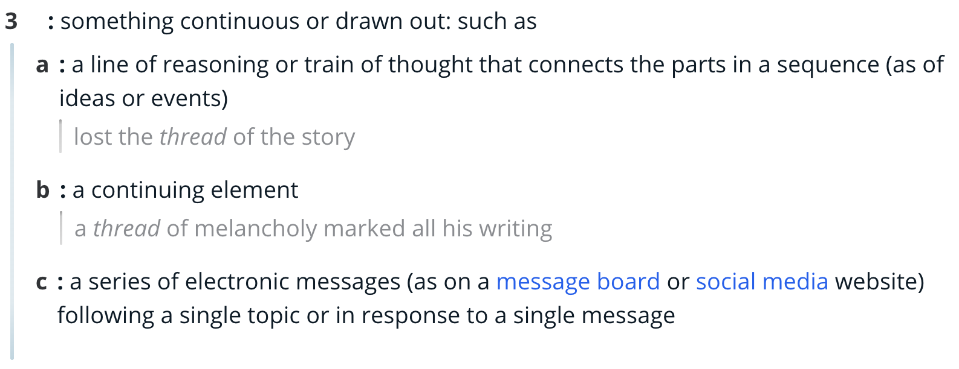
Program is also data
Thread: A thread of continuous instructions to execute.

Slide 41
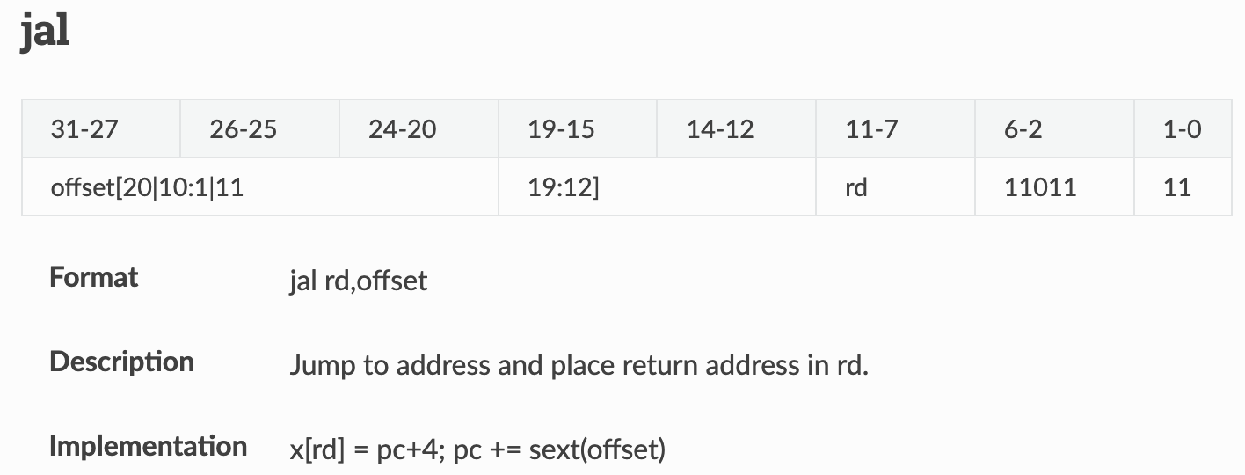
Instruction Encoding
X86
jmp label
EB FE
RISCV

